Slide 1

TRANSMITTER OF BASIC MONOCHROME TELEVISION SYSTEM

Slide 2
Presented to
Md. Imran hossain
Assistant professor
Department of ICT
Comilla University
Presented by
Kamrun nahar rimi
ID:11809013
Deparment of ICT
Comilla University

Slide 3


Television means Tele + vision which means “seeing at distance”.So television is used to see the picture telecast from long distance.

Slide 4
Basic of Monochrome TV Transmitter
Elementary area of picture is broken into ”picture element”
There are almost infinite elements in any picture, so information of picture is very complex.
Each elements has different level of brightness.

Slide 5
Basic of Monochrome TV Transmitter
Information is given as a function of two variables, space and time.
Ideally, there is infinite elements of information in optical domain.
Practically, conversion of optical elements into electrical form is done, and its transmission is carried out element by element.
Scanning of elements is done at a very fast rate and this process is repeated a large number of times per second to create an illusion of simultaneous pick up and transmission of picture details.

Slide 6
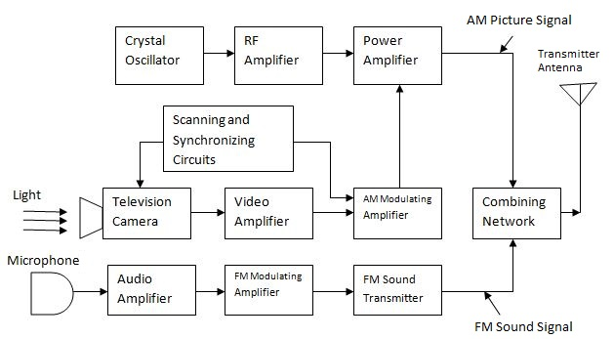
Basic Monochrome Television Transmitter

Slide 7
Television Camera: its function is to convert optical image of television scene into electrical signal by the scanning process.
Video Amplifier: video amplifier amplifies the video signal
AM Modulating Amplifier: the video signals are amplified by the modulating amplifier to get the modulated signal.
Audio Amplifier: Audio amplifier amplifies the electrical form of audio signal from the microphone.

Slide 8
FM Modulating Amplifier: Sound signal from audio amplifier is frequency modulated by FM modulating amplifier.
FM Sound Transmitter: FM modulated amplified signal is transmitted through this FM sound transmitter to transmitting antenna through the combining network.
Crystal oscillator: Crystal Oscillator generates the allotted picture carrier frequency.
FR Amplifier: RF amplifier amplifies the picture carrier frequency generated by crystal oscillator to required level.
Power Amplifier: Power amplifier varies according to the modulating signal from AM modulating amplifier.

Slide 9
Parameters of Monochrome TV Transmitter
It has a video information, in between black & white with the shades of gray.
it transmits on channels in the VHF and UHF.
Picture and sound signals are modulated on RF carrier to reduce antenna size.

Slide 10


